Slide 1

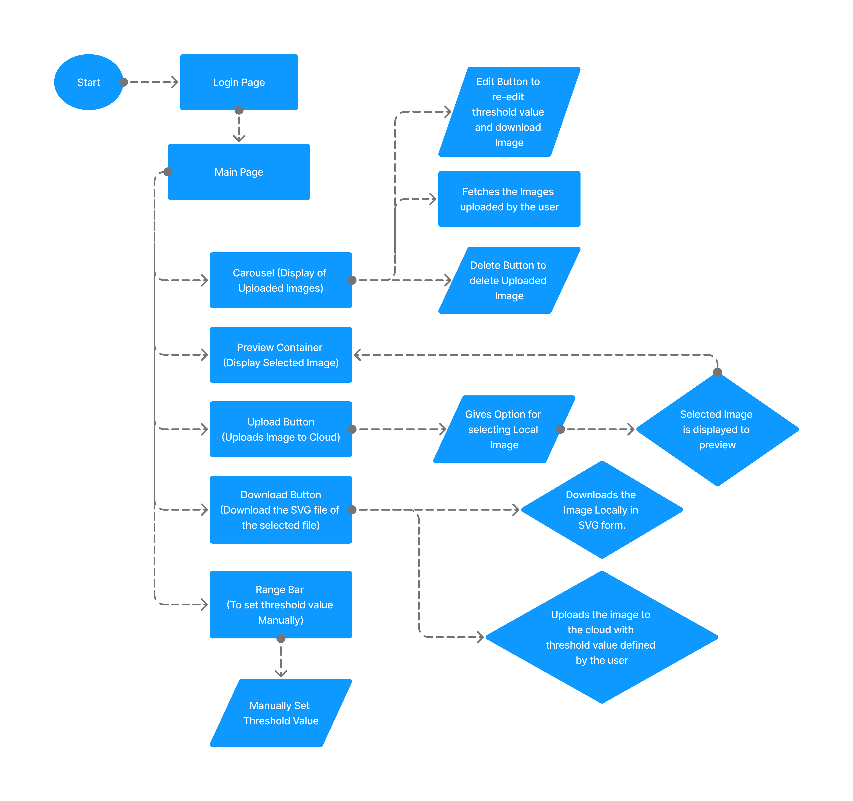

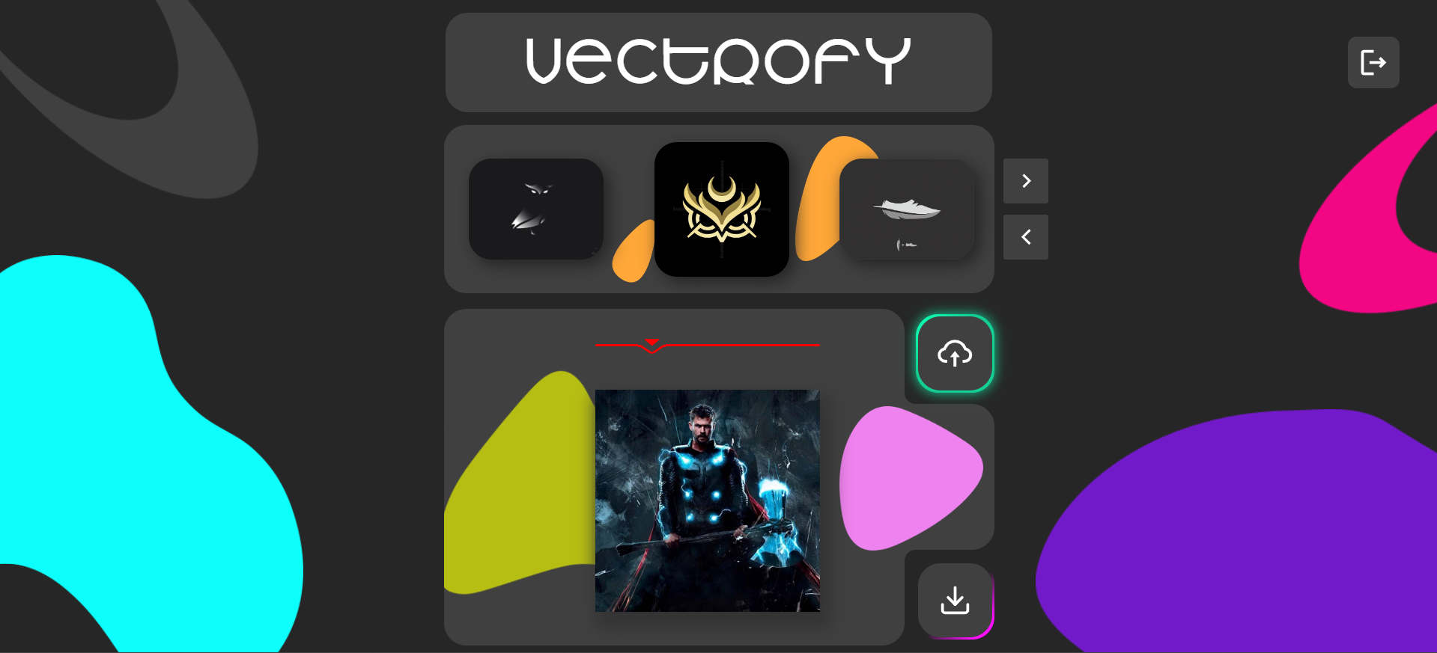
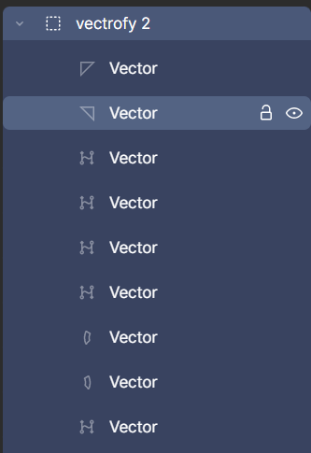

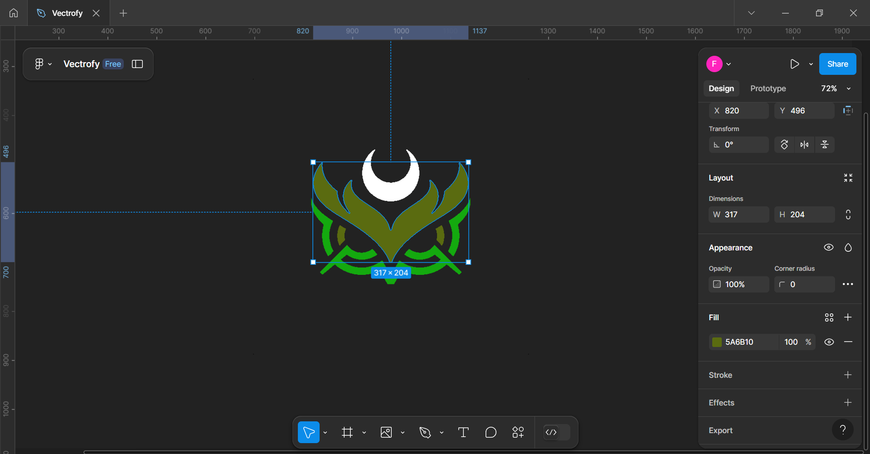
SOCCA-55 | Vectrofy
Guided by Prof. Harshil Trivedi Silver Oak College Of Computer Application,
Bachelor of Computer Application, SOU
1. Falgun Sorathiya | 2. Om Patel
3. Nishith Mehta | 4. Naman Umraniya
5. Jaydeep Solanki
INTRODUCTION
SYSTEM FLOW with Experiments and Results
Vectrofy is a web-based application that addresses the growing need for scalable, high-quality graphics across various platforms. Traditional raster images, like PNG and JPG files, are often unsuitable for large-scale applications because they lose quality when resized. To overcome this limitation, Vectrofy converts these raster images into vector graphics (SVG), which are resolution-independent and maintain their sharpness regardless of scaling. By using Vectrofy, users can store and manage their images on the cloud, making it accessible from anywhere and ideal for collaborative workflows.
GOALS & OBJECTIVES
The primary objective of Vectrofy is to provide a user-friendly and efficient solution for converting raster images to vector files. It is designed to simplify the image format conversion process, allowing users to manage their image conversion tasks and access their previously converted files.
TECHNIQUES USED
MERN(MongoDB, Express.js, React.js, Node.js)
Python
Flask API
IMPLEMENTATION
We implemented Vectrofy by integrating a MERN stack web application with a Python-based image conversion microservice via Flask API, enabling cloud-based raster-to-vector image conversion.
ALGORITHM USED
Image Conversion
SVG Writing
Thresholding
Block Diagram / Circuit diagram/ Drawings
User
User Interaction (Upload Image, Sign Up/Sign In)
FUTURE SCOPE
The future scope of Vectrofy includes enhancing its image conversion capabilities through the integration of advanced machine learning algorithms for more precise vectorization and intelligent pattern detection. Expanding cloud storage options and enhancing the UI for mobile users could further broaden its usability and appeal across industries.
Image Conversion
(Flask)
- Convert PNG/JPG to SVG
- Adjustable Threshold
Front-End (React)
CONCLUSION
Backend
(Express & Node.js)
- API for image upload
- API for authentication
MongoDB
(User Data, Images)
- Store User Details
- Store Image file
In conclusion, Vectrofy provides an essential solution for modern design and development by delivering a high-precision tool for raster-to-vector conversion. It empowers users to scale their visuals infinitely, retain full control over design elements, and make edits seamlessly—all while maintaining the integrity of the original image. As the demand for scalable, editable, and efficient graphics grows across industries, Vectrofy stands out as a powerful asset for professionals seeking to streamline and optimize their design workflows.
.
REFERENCES
- MERN Course: https://www.udemy.com/course/react-nodejs-express-mongodb-the-mern-fullstack-guide/
- Redux Tutorial: https://youtube.com/watch?v=1i04-A7kfFI&t=3245s
- Image Upload in Cloud: https://www.youtube.com/watch?v=YH63fnqG7F0&t=1s
- Raster Image to Vector Conversion: https://youtu.be/i_9tAee-hYo?si=snPzcD_ujSKaS7TU
- Flask Python and React Integration: https://www.geeksforgeeks.org/flask-tutorial/

